Slide 1
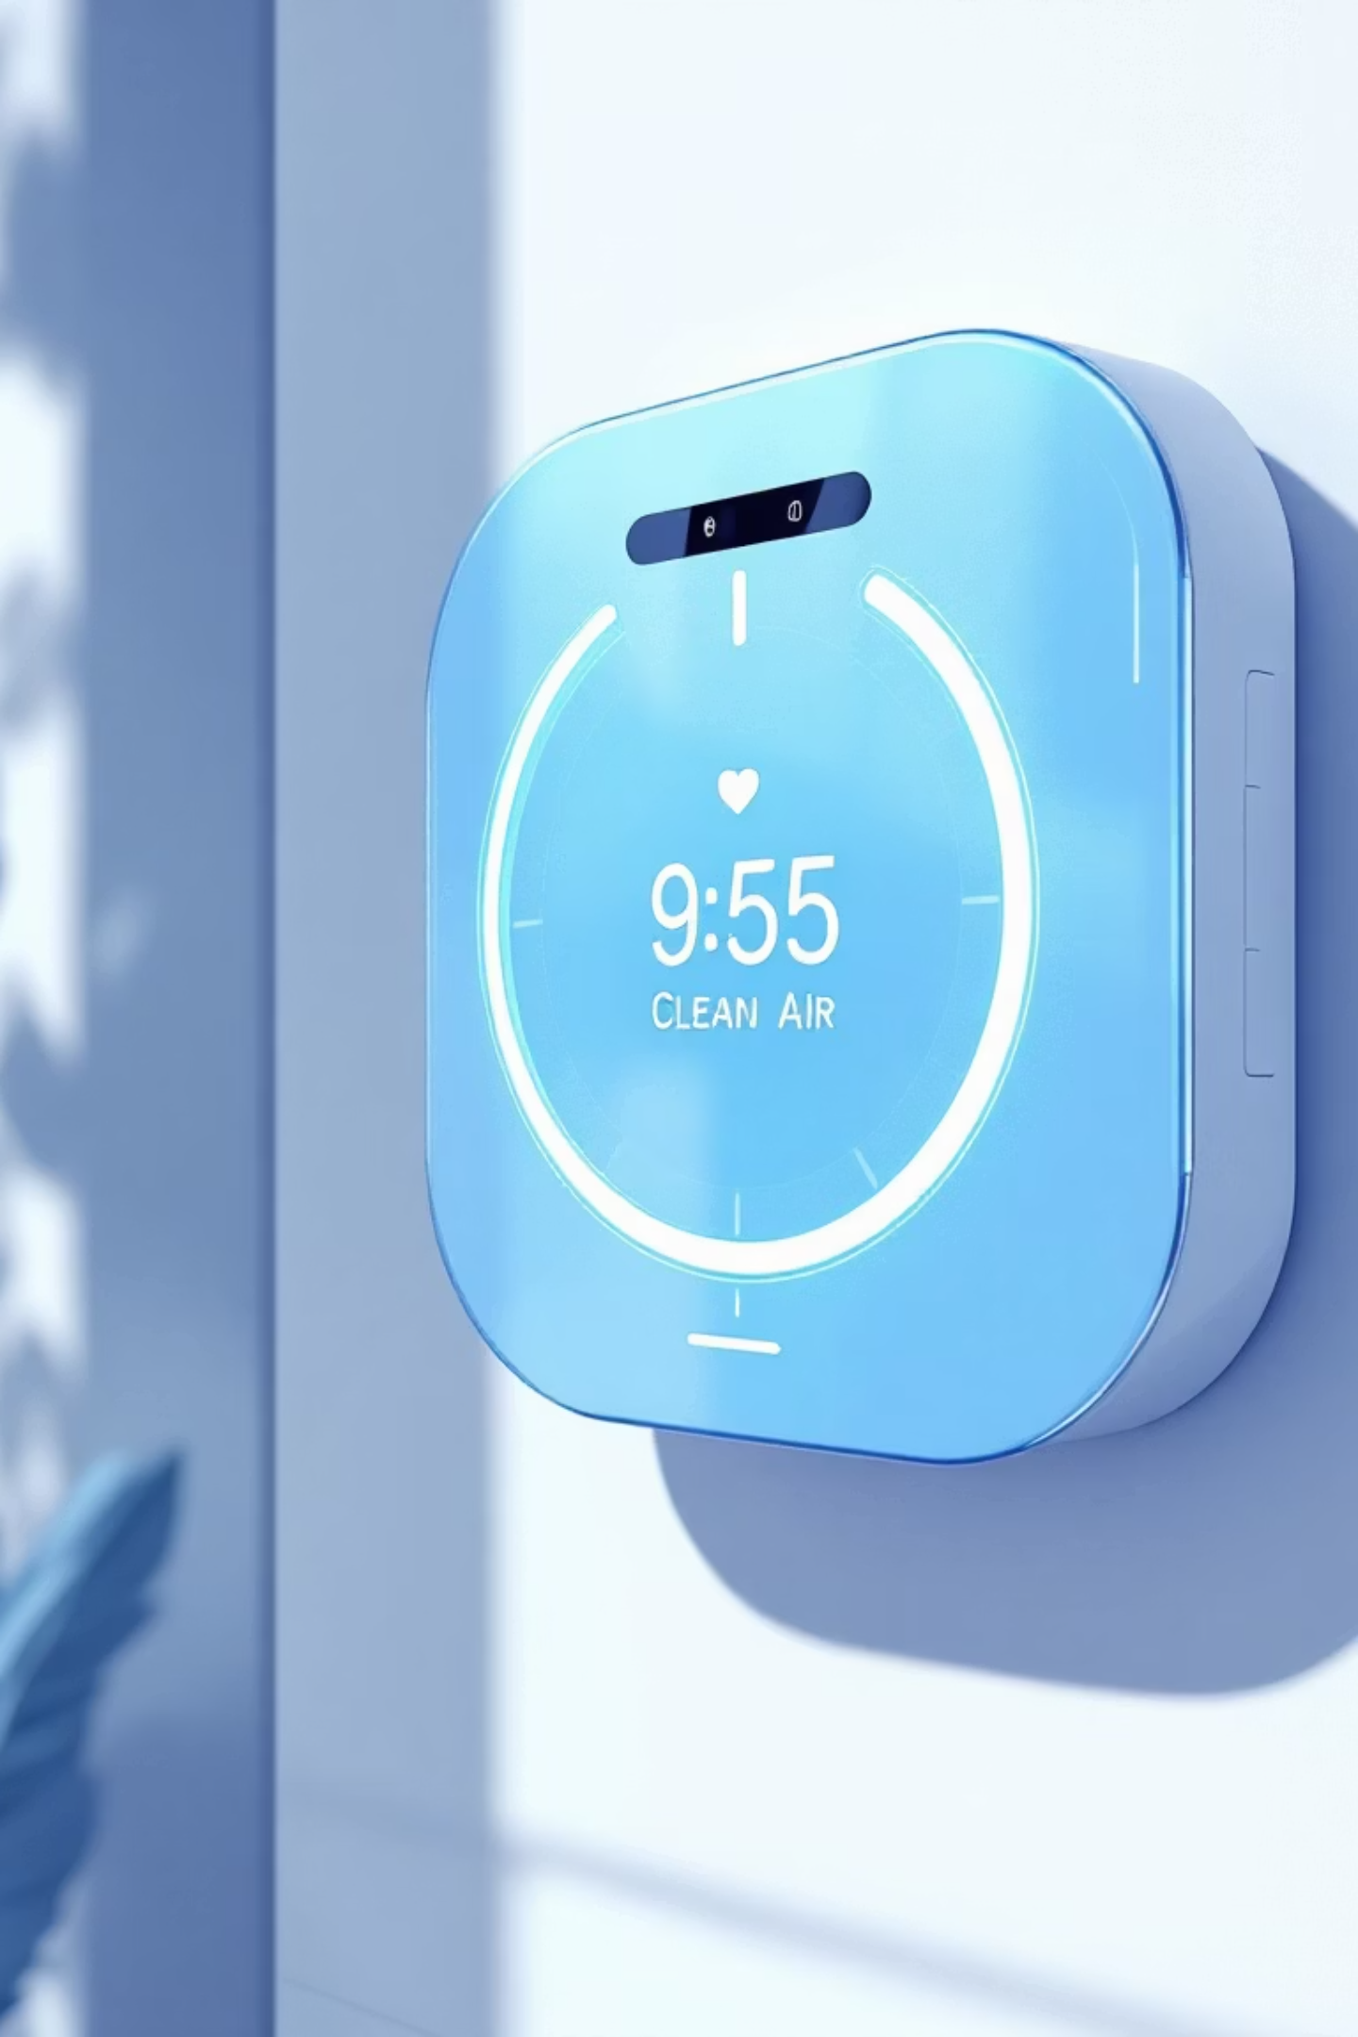
Smart Allergy & Air-Response System (SAARS)
An IoT-based solution for mitigating respiratory health risks by monitoring indoor air quality in real-time.

Slide 2

Project Report: Documentation
Introduction to SAARS
This project presents the Smart Allergy and Air-Response System (SAARS), an IoT-based solution designed to mitigate respiratory health risks by monitoring indoor air quality in real-time.
Name: Abdul Hannan, Massad Syed, Arslan Ali
Class: BSCS ‘A’
Registration No: 23-NTU-CS-1002,1048,1019
Course: Embedded IOT FALL -2025
Submitted To: Sir Nasir Sb
Submission Date: 4 January 2026

Slide 3
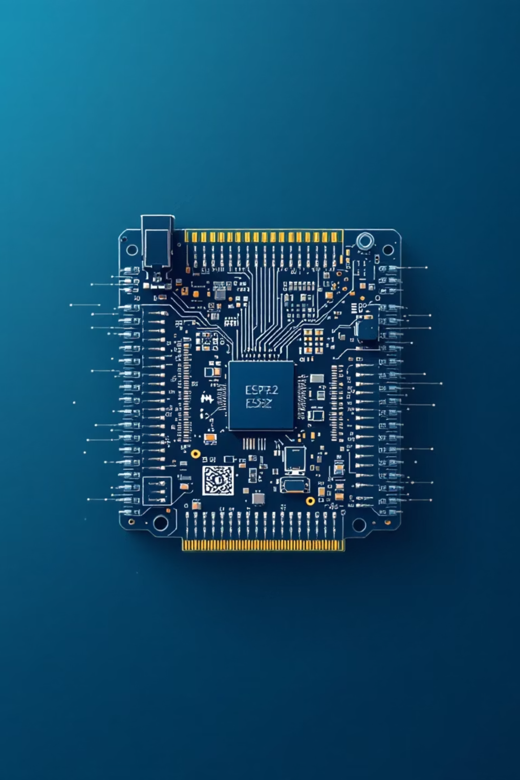
Abstract: Real-time Air Quality Monitoring
SAARS integrates an ESP32 microcontroller with MQ-135, DHT22, and PM2.5 Dust Sensors to detect harmful pollutants, high humidity, and particulate matter.
1
2
Remote Data Visualization
Automated Response
Utilizes Blynk Cloud for remote data visualization and instant mobile notifications.
Activates a ventilation fan via a relay when air quality exceeds safety thresholds.
3
Preventive Healthcare
Offers a low-cost, scalable approach to preventive healthcare.

Slide 4

Problem & Objectives
Airborne allergies and respiratory issues are increasing due to poor indoor air quality and lack of real-time monitoring. Existing systems are either expensive or reactive.
Monitor Air Quality
Real-time monitoring of key air quality parameters.
Detect Allergy Triggers
Early detection of allergy-triggering conditions.
Automatic Response
Provide an automatic environmental response to poor air quality.
Remote Notifications
Notify users remotely using IoT capabilities.
Data Analysis
Store and visualize data for long-term analysis.

Slide 5
Hardware Components
The SAARS system utilizes a suite of sensors and components integrated with an ESP32 microcontroller.
Component
Pin Type
ESP32 Pin
Function
MQ-135 Sensor
Analog
GPIO 34 (ADC1)
Measuring Air Quality Index (AQI)
DHT22 Sensor
Digital
GPIO 4
Measuring Temperature & Humidity
PM2.5 Dust Sensor
Analog/PWM
GPIO 35
Measuring Particulate Matter
OLED Display
I2C (SDA)
GPIO 21
Data Visualization
Relay Module
Digital
GPIO 5
Controlling Exhaust Fan
Buzzer
Digital
GPIO 18
Local Audible Alert

Slide 6




Software Ecosystem
Designed for high-speed data processing and dual-path cloud communication, using Arduino IDE for firmware development.
Blynk IoT Platform
Firebase Real-time DB
Primary GUI for real-time data visualization and mobile push notifications.
NoSQL cloud database for permanent data persistence and historical analysis.
Communication Protocols
HTTP/SSL for Firebase updates and Blynk Protocol for low-latency control.

Slide 7
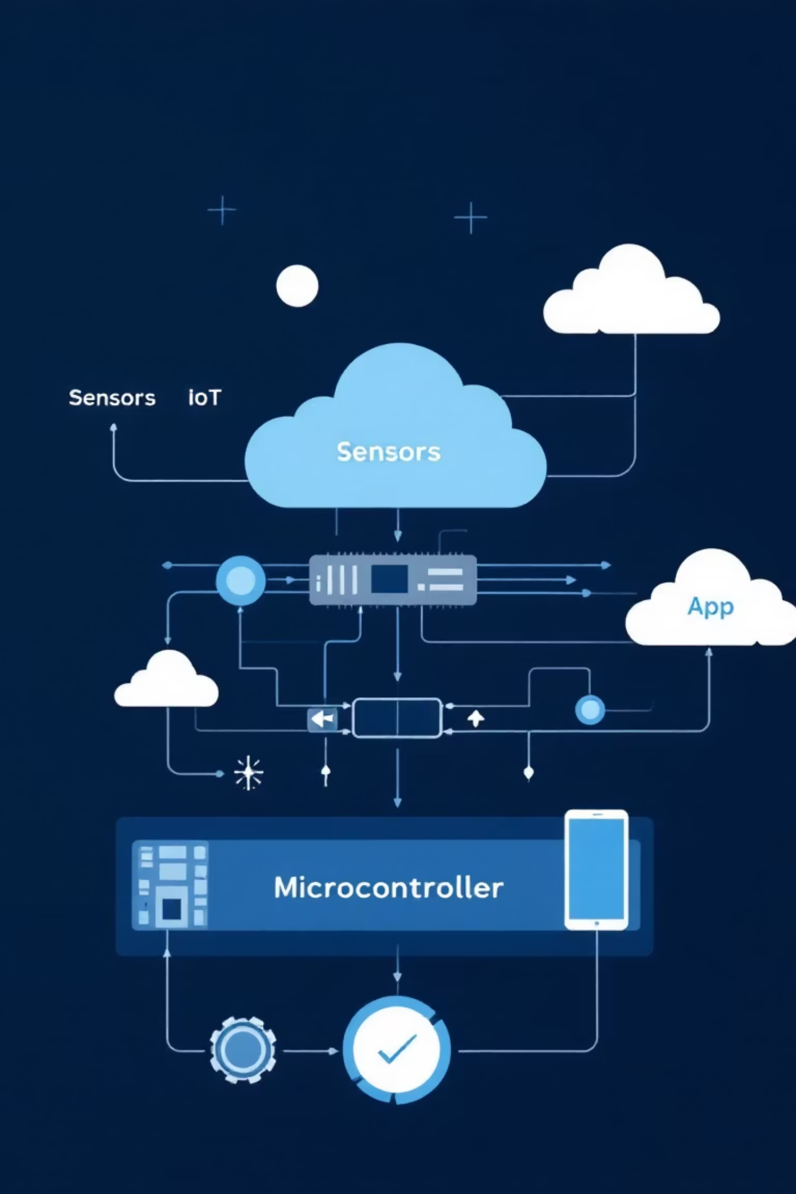
System Architecture
SAARS follows a multi-tier IoT model to ensure reliability and scalability.
01
Perception Layer
MQ-135, DHT22, and PM2.5 sensors capture raw environmental data.
02
Processing Layer
ESP32 Microcontroller digitizes sensor signals and executes threshold logic.
03
Connectivity Layer
ESP32 pushes data to Blynk Cloud for monitoring and Firebase for storage.
04
Application Layer
Users interact via the Blynk Mobile App for statistics and alerts.

Slide 8

Implementation Details
Hardware interfaced with ESP32; firmware samples data every 2 seconds.
Dual-Cloud Integration: Secure data transmission using unique Authentication Tokens for Blynk and Database Secrets for Firebase.
Automation Logic: "Smart-Response" algorithm triggers exhaust fan and buzzer if PM2.5 or Gas levels exceed thresholds.
Local Visualization: I2C-based OLED display provides immediate local readout, functional without internet.

Slide 9

Testing & Results
SAARS was tested under baseline and pollutant detection scenarios.
Scenario A: Baseline
System in ventilated room. AQI below threshold, fan OFF, OLED displayed "Air Quality: Good".
Scenario B: Pollutant Detection
Smoke introduced near MQ-135. AQI spiked above threshold.
Response:
Relay activated Exhaust Fan, Buzzer sounded, and notification pushed to Blynk Mobile App.

Slide 10




Conclusion & Future Scope
SAARS successfully demonstrates a proactive approach to allergy management through IoT.
AI-Based Predictive Analytics
Solar Power Integration
Mobile App Expansion
Scalable Mesh Networking
Integrate ML models to predict "Allergy Risk Days".
Implement solar charging for energy-autonomous operation.
Add a "Health Log" feature to correlate symptoms with air quality.
Develop multi-node networks for entire building ventilation management.

